Slide 1
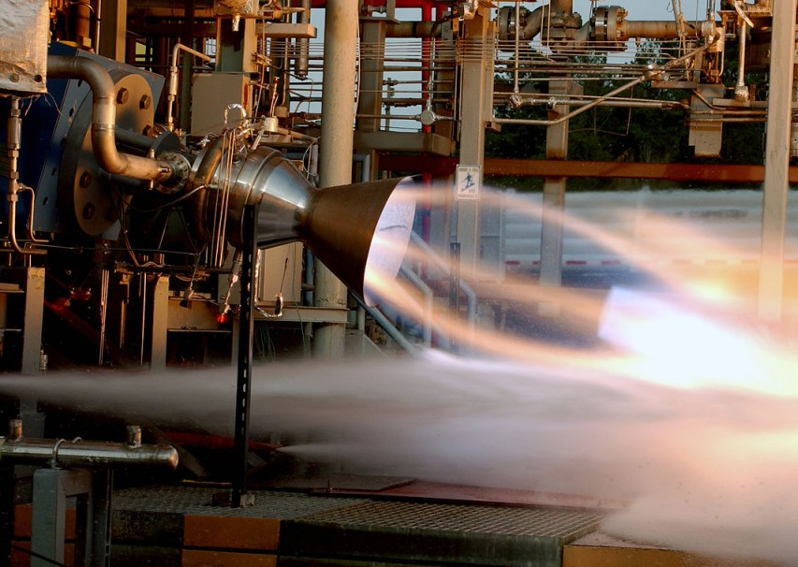
Solid Rocket Grain Configuration
Ian Bjelke, Anthony Guerra, Josh Oates
AERO 303 Lab, Research Group 7

Slide 2
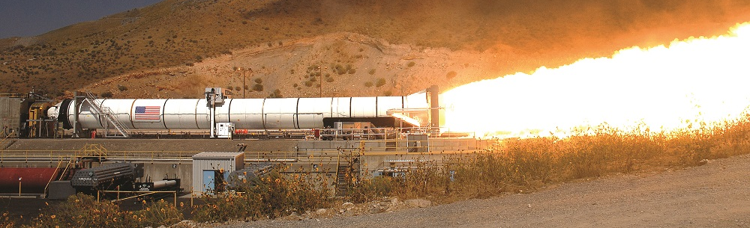
Introduction
Basics of solid rocket motor grain configurations
History – evolution of solid rocket motor technology
Components and Configurations – basic parts of a rocket motor
How it Works – comparison of different grain configurations for different missions
Current and Future Applications – why grain configuration is important today and in the future

Slide 3

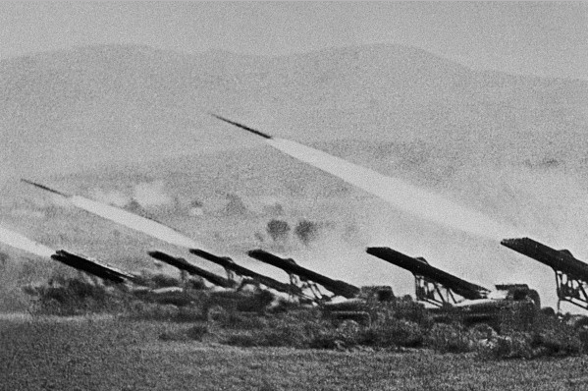
History
Solid rockets initially used as fireworks by the Chinese in the first century [4]
Over the centuries, solid rockets were continually repurposed into what we have today [4]
Early-mid 1900's (times of war), several countries progressed solid rockets, introducing different grain configurations [5]

Slide 4
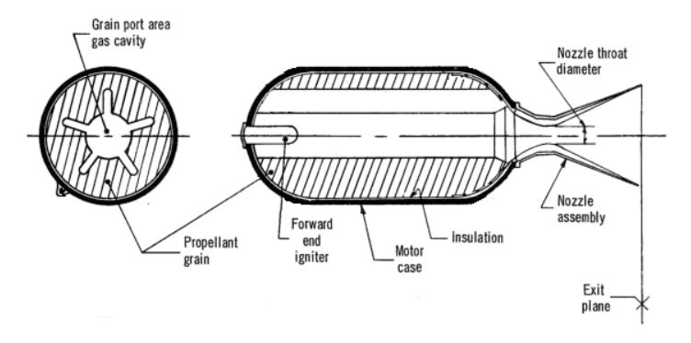
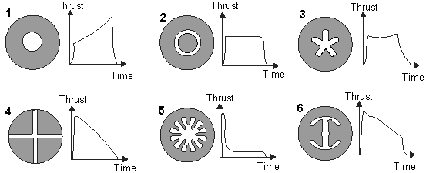
Components / Grain Configurations
Solid rocket propellant manufactured cylindrically
Encased in outer insulation and motor casing
Open nozzle at one end allows gas to produce thrust in one direction
Igniter causes propellant to react and burn
Propellant grain can feature various cross-section patterns
Fuel + oxidizer form solid-state grain
Grain burns outward from motor center to walls of motor casing
Grain design determines burn development (progressive/neutral/regressive)
Components of Solid Rocket Motor [1]
Grain Cross Section and Respective Thrust Behavior [2]

Slide 5
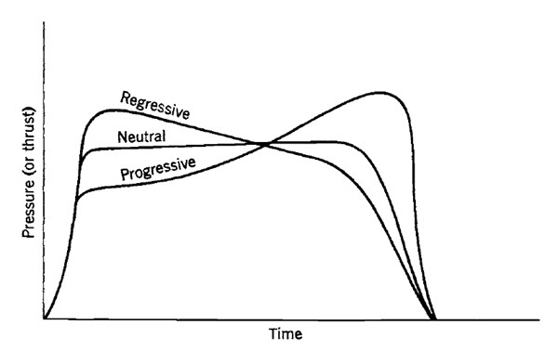
How it Works
Progressive vs. Regressive grain configuration
Progressive configuration
Weaker early burn stage
Thrust force increases with time until propellant used up
Regressive configuration
Stronger early burn stage
Thrust force decrease with time until propellant used up
Surface area
The thrust curves are dictated primarily based on how much surface area of the fuel is exposed at any given time
Based on initial surface area exposed and shape of remaining fuel
Small initial surface area
Increases with time
Large initial surface area
Decreases with time

Slide 6
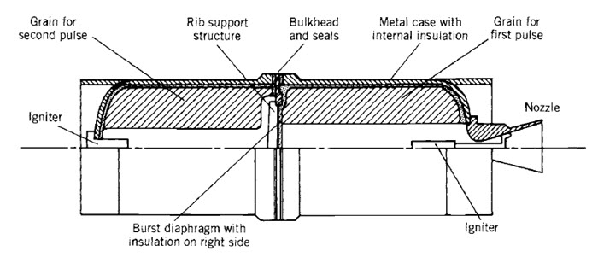

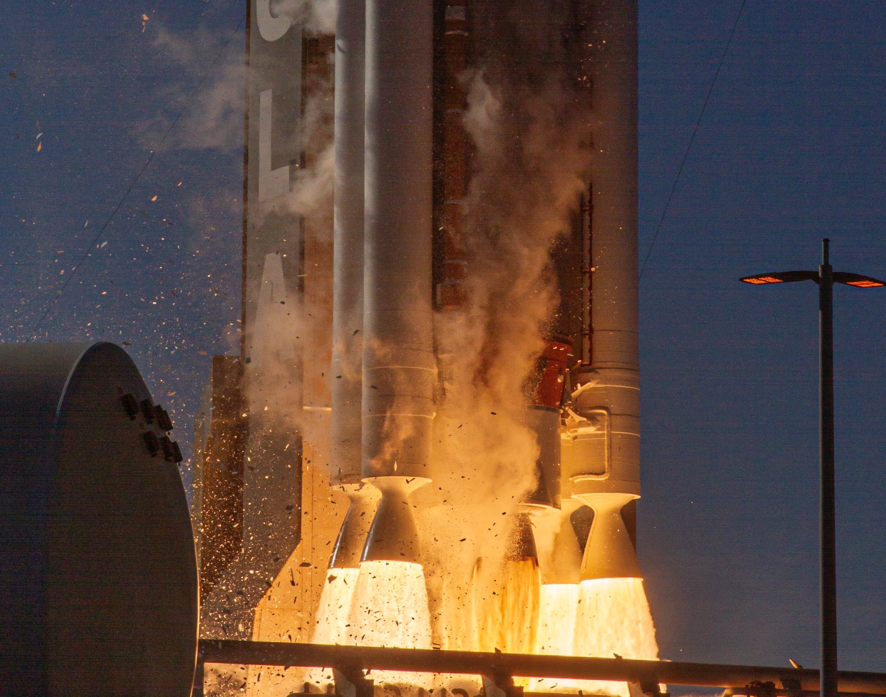
Current Applications
Solid rocket boosters—provides initial thrust to rockets during launch
Atlas V, Artemis, SLS, Space Shuttle
Comes in different grain configurations based on mission-specific applications
Restartable rocket motors
Different grain configurations separated by bulkhead to ignite individually [6]
Solid rocket motor on aircraft for better takeoff performance [7]

Slide 7
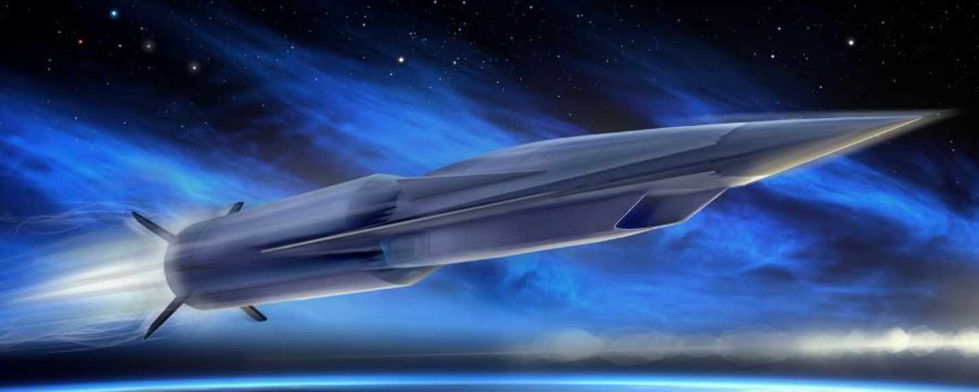
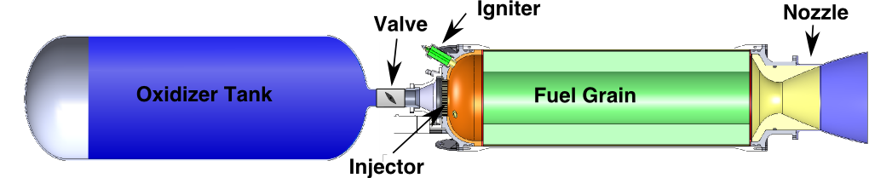
Future Applications
Aerojet Rocketdyne solid rocket advances [3]
Successful testing of large solid rocket motor (eSR-73)
Selected to build second stage solid rocket booster for DARPA hypersonic weapon system
Graphene organogels for hybrid rockets [8]
Could be used to greatly increase the ISP of hybrid rockets
Hybrid rockets will still have a grain structure
Could be used on interplanetary missions where cryogenic fuels present challenges, but throttleable thrust is important

Slide 8
Conclusion
Solid rockets have been in use since the first century and therefore the grain configuration has been relevant since then
Grain configuration is important at controlling the burn rate and thrust curves of solid rockets
The surface area of the fuel grain burning at a point in time is the main contributor to thrust and burn rate
Grain configurations have relevance to short take-off aircraft and hybrid rocket design

Slide 9
References
[1] Johannsson, M., “Optimization of Solid Rocket Grain Geometries,” thesis, 2012.
[2] Nakka, R., Richard Nakka's Experimental Rocketry Site Available: https://www.nakka-rocketry.net/th_grain.html.
[3] “Solid Rocket Motors,” Aerojet Rocketdyne Available: https://www.rocket.com/innovation/solid-rocket-motors.
[4] Green, Becky, and Christy Hales. “History of Solid Rockets - NASA Technical Reports Server (NTRS).” NASA, NASA, https://ntrs.nasa.gov/citations/20170012460.
[5] “Propellant Grain.” Propellant Grain - an Overview | ScienceDirect Topics, https://www.sciencedirect.com/topics/earth-and-planetary-sciences/propellant-grain.
[6] “Propellant Grain Design Considerations - Propulsion 2.” Aerospace Notes, 29 June 2021, https://aerospacenotes.com/propellant-grain-design-considerations/.
[7] Fraser November 1949, p. 142.
[8] Sierra Padilla, Jessica North, Amber Stricklen. "Characteristics of Reverse Hybrid Rocket Propellants Based on Nanomaterials ", Southern Utah University, https://digitalcommons.usu.edu/spacegrant/2022/all2022/17/

